Slide 1

Predicting Fraudulent E-Commerce Transactions
Group 8
Notes:
Our Project Topic is the Analysis of Job Market Trends in the US.

Slide 2

Project Overview
Utilized two datasets for analysis:
Version 1: A larger dataset containing 1,472,952 transactions without a binary fraud indicator, which served as the test dataset for evaluating the model’s performance.
Version 2: A smaller dataset containing 23,634 transactions, which included a binary indicator of fraudulence (1 for fraudulent, 0 for legitimate). This dataset was used for training and evaluating machine learning models.
Objective:
Develop a fraud detection model achieving an accuracy of 75% or higher.
Address the class imbalance, where only 5% of transactions were fraudulent.
Notes:
Our project focused on Detecting Fraudulent E-Commerce Transactions using machine learning. Fraud detection is a critical issue in today’s digital marketplace, and we set out to create a model that could identify fraudulent transactions accurately and efficiently.
We worked with two datasets:
• Version 1, our larger dataset with over 1.4 million transactions, served as the test dataset. This dataset did not include a fraud indicator, which meant it was used solely to evaluate our model’s performance.
• Version 2, a smaller dataset with 23,634 transactions, included a binary fraud indicator—1 for fraudulent and 0 for legitimate—and was used for training and evaluation.
Our objective was twofold:
1. Develop a fraud detection model capable of achieving 75% or higher accuracy for both fraudulent and legitimate transactions.
2. Address the class imbalance in the dataset, where only 5% of transactions were fraudulent. This imbalance made it challenging to detect fraud effectively without favoring legitimate transactions.
To meet these goals, we tested three machine learning models, focusing on building a scalable solution that balanced accuracy and fairness across both classes, even with imbalanced data.

Slide 3
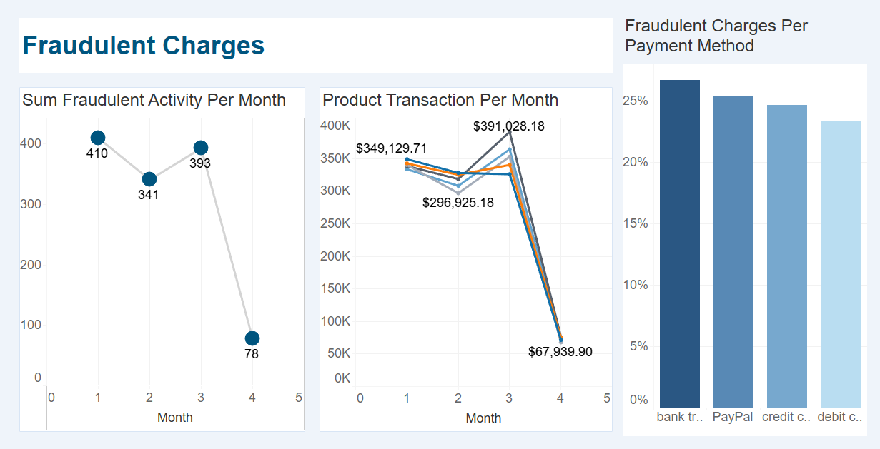
Fraudulent Transactions Visualizations
Notes:
The visuals in this dashboard were generated from the smaller dataset with 23 thousand transactions.
As you can see from the charts, the number of fraudulent charges directly correlates with how much is being spent.
We also saw that bank transfers had the highest percentage of fraudulent charges, while debit cards had the lowest percentage of fraudulent charges.
According to Experian.com, Credit cards are safer than debit cards because under federal law, they provide greater liability protection if you're a victim of fraud.
Online payments are most susceptible to fraudulent activities because you don’t have to show a physical card.

Slide 4
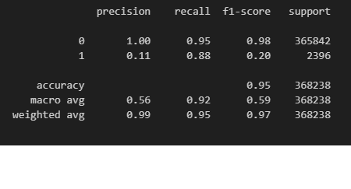
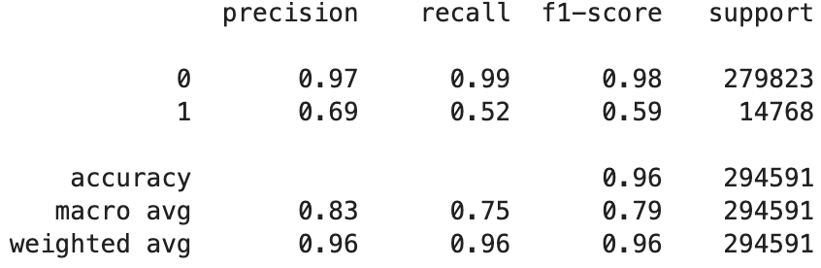
Model Selection: Logistic Regression versus XGBoost
Logistic Regression Model
XGBoost Model
Notes:
We initially tested a logistic regression model, which gave us strong results for overall accuracy at 95%. While precision for legitimate transactions (Class 0) was nearly perfect, the model struggled with fraudulent transactions (Class 1), achieving a precision of only 11% but a high recall of 88%. This highlighted a significant imbalance—the model flagged many false positives when predicting fraud, which is not ideal for real-world scenarios.
To address these challenges, we tested XGBoost, a gradient boosting. This approach builds a sequence of decision trees, where each tree learns from the errors of the previous ones to iteratively improve performance. This approach achieved an overall accuracy of 96% and improved performance for Class 1 with a precision of 69% and an F1-score of 59%. The model provided a better balance between precision and recall, significantly reducing false positives compared to logistic regression. In addition, its scalability allowed it to handle the larger dataset much more efficiently, making it a practical choice for real-world application.
Analysis:
With XGBoost, we effectively addressed the dataset imbalance and achieved robust fraud detection results. The model demonstrated high accuracy for legitimate transactions and a more balanced trade-off for identifying fraudulent ones, technically meeting our goal of 75% accuracy or higher. However, the relatively low precision and recall for fraudulent transactions indicate that the model is not yet suitable for real-world application, as it may result in too many false positives or missed fraudulent cases.

Slide 5
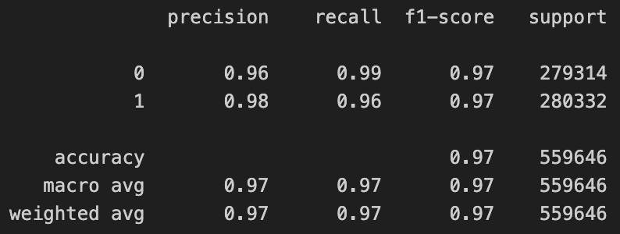
Model Selection: XGBoost versus Random Forest with SMOTE
XGBoost Model
Random Forest with SMOTE Model
Notes:
While XGBoost demonstrated significant improvements in handling the imbalanced dataset and provided a better trade-off between precision and recall compared to logistic regression, we decided to explore Random Forest with SMOTE to evaluate if better results could be achieved.
Random Forest builds multiple decision trees and aggregates their predictions for robust classification. When combined with SMOTE (Synthetic Minority Oversampling Technique), it addresses class imbalance by generating synthetic examples for the minority class. SMOTE achieves this by identifying the closest neighbors in the dataset and creating similar, yet unique, data points. This balanced dataset allows Random Forest to learn more effectively from the minority class, leading to improved performance across both majority and minority classes.
Our analysis showed that Random Forest with SMOTE achieved comparable performance to XGBoost while improving the model’s recall and precision for detecting fraudulent transactions. By addressing the dataset imbalance directly, this approach provided a scalable and practical solution for real-world fraud detection scenarios.

Slide 6
Conclusion
• Objective Achieved: Surpassed the 75% accuracy goal for both legitimate and fraudulent transactions.
• Class Imbalance Addressed: SMOTE effectively balanced the minority fraud class for improved model training.
• Best Model: Random Forest with SMOTE outperformed others, achieving comparable precision, recall, and F1-scores for both classes.
• Scalability: Models demonstrated strong performance on both smaller and larger datasets (23k and 1.4M+ transactions).
• Real-World Applicability: Established a solid foundation for fraud detection strategies while highlighting areas for continued improvement.
Notes:
In conclusion, our project set out to tackle the critical challenge of detecting fraudulent e-commerce transactions using machine learning. From the beginning of this project, we faced two significant hurdles: the highly imbalanced nature of the dataset, where only 5% of transactions were fraudulent, and the need to achieve an overall prediction accuracy of 75% or higher for both legitimate and fraudulent transactions.
Through testing various models, including logistic regression, XGBoost, and Random Forest with SMOTE, we evaluated different approaches to balance precision, recall, and scalability. Each model offered unique strengths: logistic regression provided a solid baseline, XGBoost excelled in handling large datasets efficiently, and Random Forest with SMOTE effectively addressed class imbalance by generating synthetic data for the minority class. Ultimately, the Random Forest with SMOTE model stood out, achieving comparable performance for both classes and surpassing our initial accuracy goals.
This project not only reinforced the importance of addressing dataset imbalances but also demonstrated how different machine learning techniques can complement one another in solving complex problems. While there’s always room for improvement, especially in enhancing recall and minimizing false positives for fraud detection, we believe this work serves as a solid foundation for real-world applications and further exploration into fraud prevention strategies.

Slide 7

Thank you

